Slide 1
LinqUs Provisioning Manager
Interface gráfica de usuario (GUI)

Slide 2
Agenda
Menú principal LPM
Menu de suscripción
Menu Batchload
Menu de monitoreo
Menu de información de producto
Menu de ayuda

Slide 3
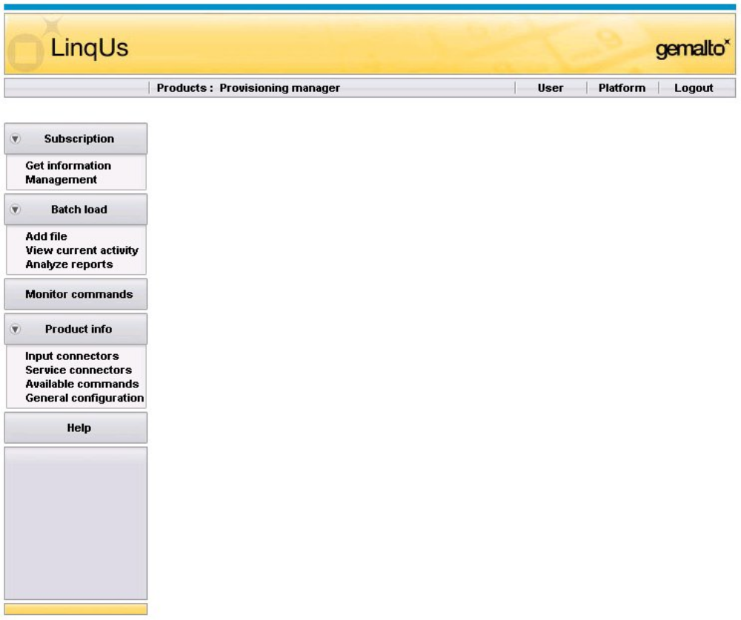
Interfase LPM / página principal
Menus disponibles LPM

Slide 4
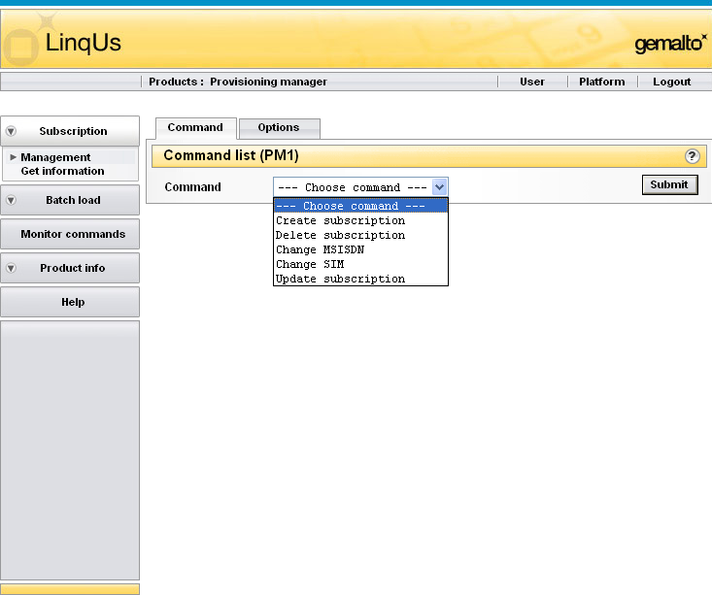
Interfase LPM / Suscripción (1)
Administración > Comando (selección de comando)

Slide 5
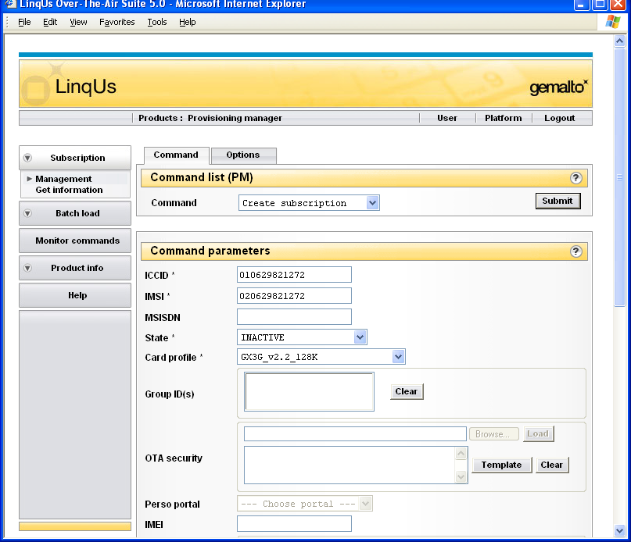
Interfase LPM / Suscripción (2)
Administración > Crear comando suscripción
* Indica que el campo es obligatorio

Slide 6
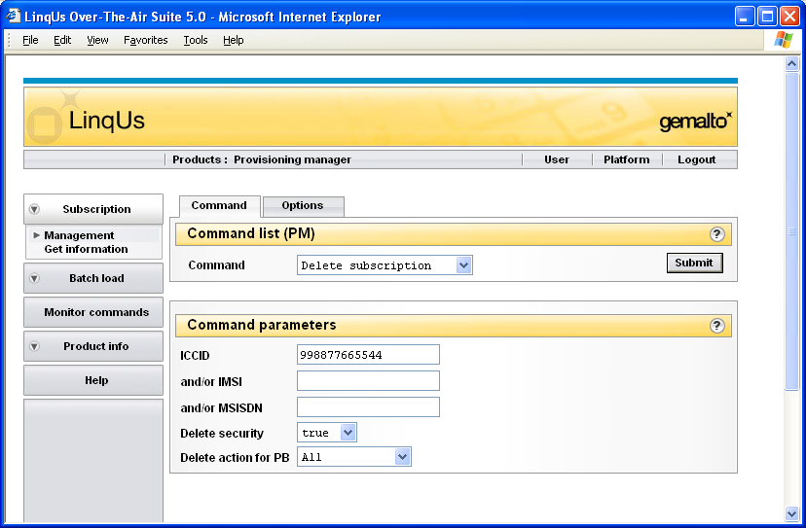
Interfase LPM / Suscripción (3)
Administración> Eliminar comando suscripción
Verdadero
Falso
TODOS
Todos excepto usuario
nada

Slide 7
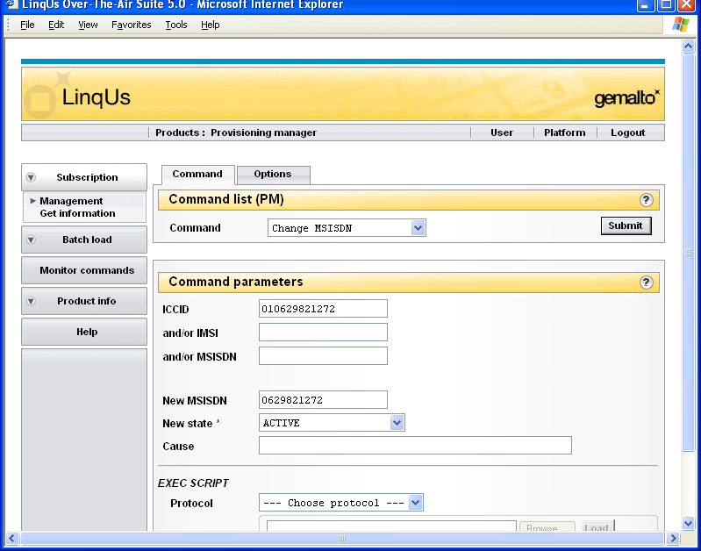
Interfase LPM / Suscripción (4)
Administración > Cambiar comando MSISDN

Slide 8
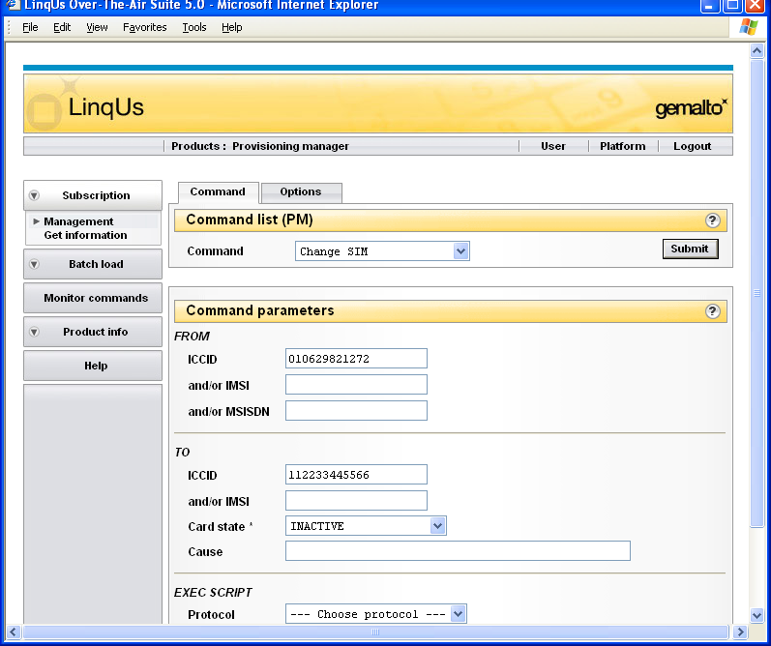
Interfase LPM / Suscripción (5)
Administración > Cambiar comando SIM
Este CCID debe ya existir

Slide 9
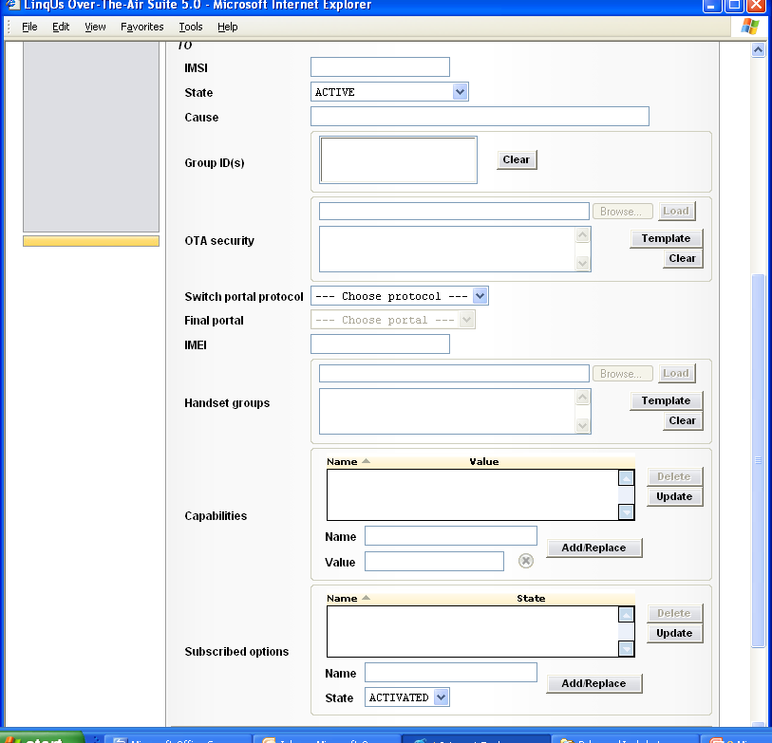
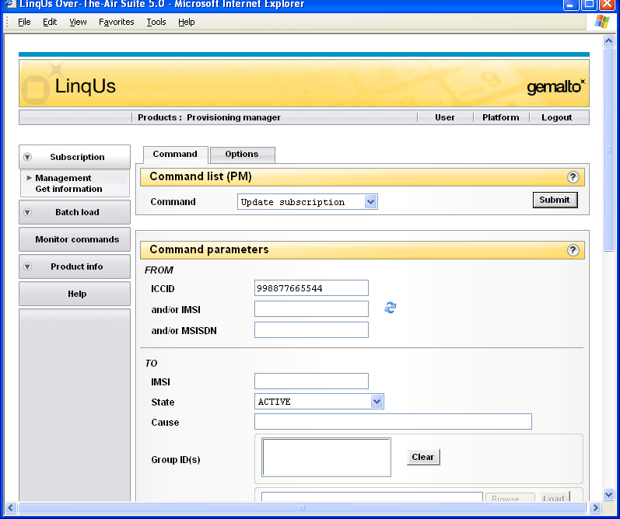

Interfase LPM / Suscripción (6)
Administración > Actualizar comando de suscripción
Click here to dynamically update below fields related to ICCID, IMSI or MSISDN value
Notes:
Double blue arrows close to “and or IMSI” field: Click to dynamically update the values of fields directly related to the ICCID, IMSI, or MSISDN. Entries in the Capabilities and Subscribed options lists are also dynamically updated. Move the mouse over the icon to display a list of the dynamic fields affected.

Slide 10
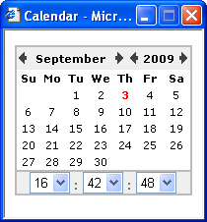
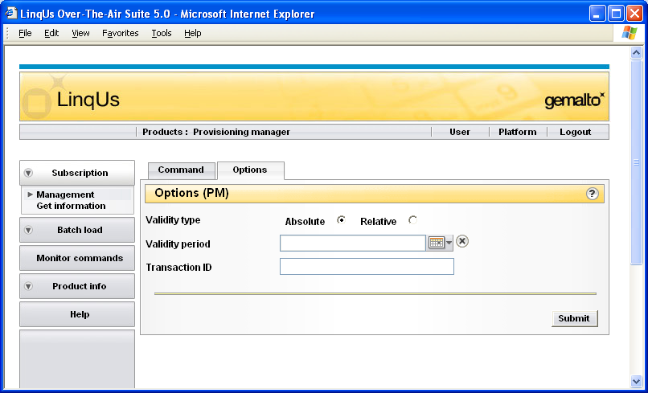
Interfase LPM / Suscripción (7)
Administración > Opciones de comando
Notes:
Validity Type:
■ Absolute. Specify a date and time limit for delivery. Do this by clicking the calendar
button to the right of the field: adjust the time (if necessary) and then select a
date. To remove a validity period, click the button to the right of the calendar.
■ Relative. Specify the validity period as the number of hours, minutes, and seconds
allowed for delivery once the request is processed. For example, to specify that the
request must be completed within two days of the processing date, enter “48” in the
hours box.
Validity period
The time limit for delivery of the request to the subscriber's phone. Type the validity
period, or click the calendar button and select a validity period. If the command
cannot be delivered within the defined period, it is marked as “Expired” and there are
no further attempts to deliver it.
If you do not set a validity period, LinqUs Provisioning Manager continues to attempt to
deliver the request until a separate timeout period (defined by the administrator) is
reached.

Slide 11
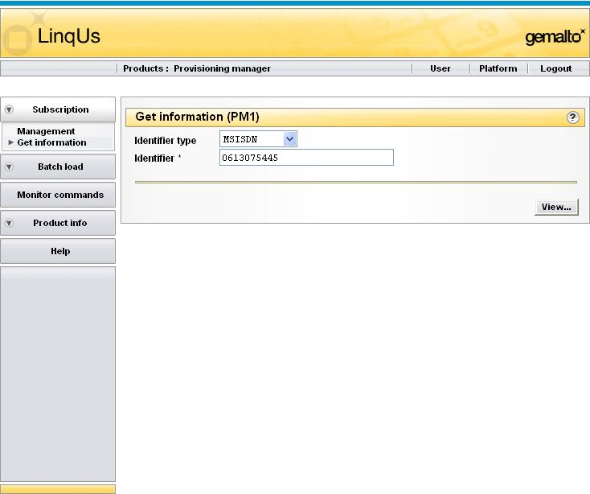
Interfase LPM / Suscripción (8)
Obtener información (Selección de suscripción)

Slide 12
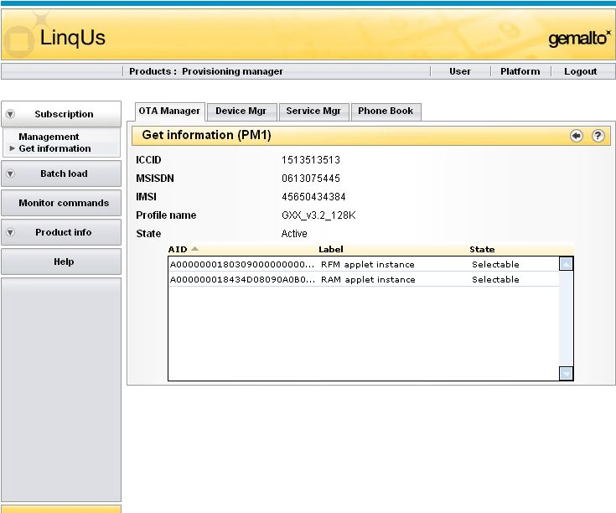
Interfase LPM / Obtener información de suscripción(1/5)
Obtener información > Información de suscripción (OTA Manager)
Notes:
Get Information - OTA Manager
The Get Information - OTA Manager window displays OTA Manager-related information for the selected subscription.
The following information about the selected subscription is displayed:
■ ICCID. The ICCID of the card
■ MSISDN. The MSISDN of the card
■ IMSI. The IMSI of the card
■ Profile name. The name of the subscription's card profile
■ State. The current state of the card: Active or Inactive.
This is followed by a list of all the applets currently installed on the card. The following information is shown for each applet:
■ AID. The applet's AID, as defined in ISO7816-5: a byte string 5 to 16 bytes long (32
characters maximum, shown in uppercase hexadecimal).
■ Label. The label associated with the applet.
■ State. The current state of the applet:
– Installed: installed on the card
– Selectable: available for use by a subscriber
– Locked: installed but not available for use by the subscriber.
– Personalized: the applet is a security domain providing security services for
other applets associated with it. The Personalized state indicates that these services are available for use.

Slide 13
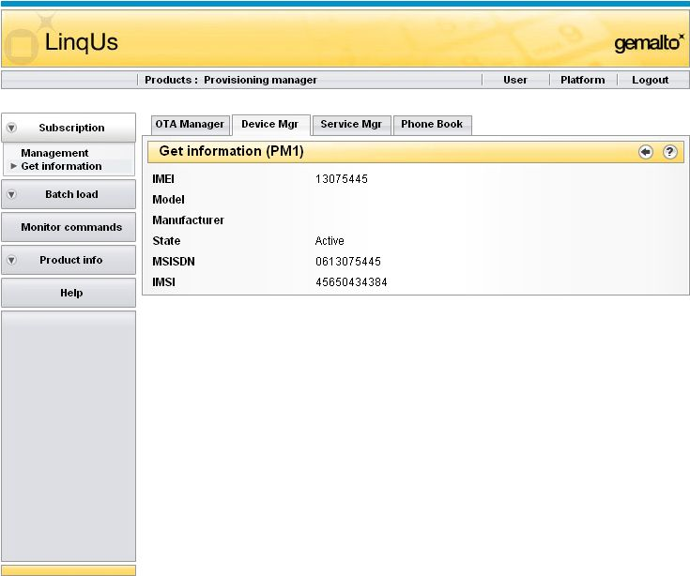
Interfase LPM / Obtener información de suscripción (2/5)
Obtener información > Información de suscripción (Administrador de dispositivos)
Notes:
Get Information - Device Manager
The Get Information - Device Manager window displays Device Manager-related information for the selected subscription.
The following information about the selected subscription is displayed:
■ IMEI. The IMEI of the device
■ Model. The Model of the device
■ Manufacturer. The Manufacturer of the device
■ State. The current device state.
■ MSISDN. The MSISDN of the subscriber associated with the device
■ ICCID. The ICCID of the subscriber associated with the device

Slide 14
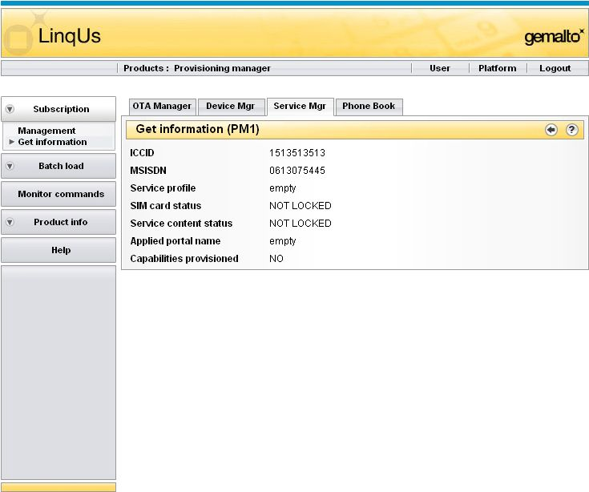
Interfase LPM / Obtener información de suscripción (3/5)
Get Information > Subscription information (Service Manager)
Notes:
Get Information - Service Manager
The Get Information - Service Manager window displays Service Manager-related information for the selected subscription.
The following information about the selected subscription is displayed:
■ ICCID. The ICCID of the subscriber associated with the device.
■ MSISDN. The MSISDN of the subscriber associated with the device
■ Service profile. The service profile name
■ SIM card status. The current status of the SIM card.
■ Service content status. The service content status
■ Applied portal name. The applied portal name
■ Capabilities provisioned. The current status of the capabilities handled in the Subscriber Manager product.

Slide 15
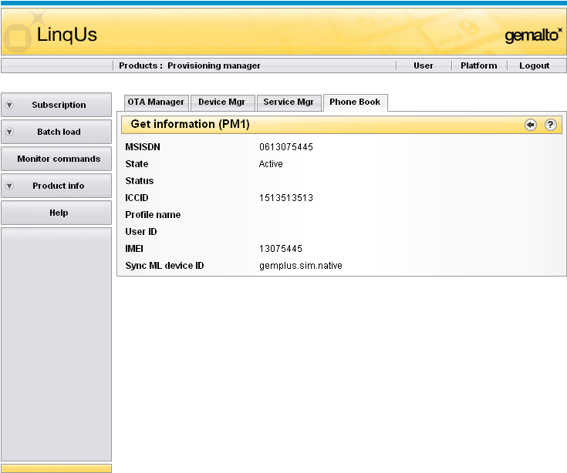
Interfase LPM / Obtener información de suscripción (4/5)
Obtener información > Información de suscripción (Phone Book)
Notes:
Get Information - Phonebook Backup
The Get Information - Phone Book window displays Phonebook Backup-related information for the selected subscription
The following information about the selected subscription is displayed:
■ MSISDN. The MSISDN of the subscriber associated with the device.
■ State. The current state of the subscriber (“Active”, “Inactive” or “Mark for deletion”).
■ Status. Whether the information necessary to back up the subscriber is partially or completely available (“Partial” or “Complete”).
■ ICCID. The ICCID of the device associated with the subscriber.
■ Profile name. The subscriber's profile name.
■ User ID. The subscriber's user ID.
■ IMEI. The International Mobile Equipment Identifier (IMEI) of the device associated with the subscriber.
■ SyncML device ID. The SyncML device identifier (for example, “gemplus.sim.native” or “3GSimcard”) of the SyncML device associated with the subscriber.

Slide 16
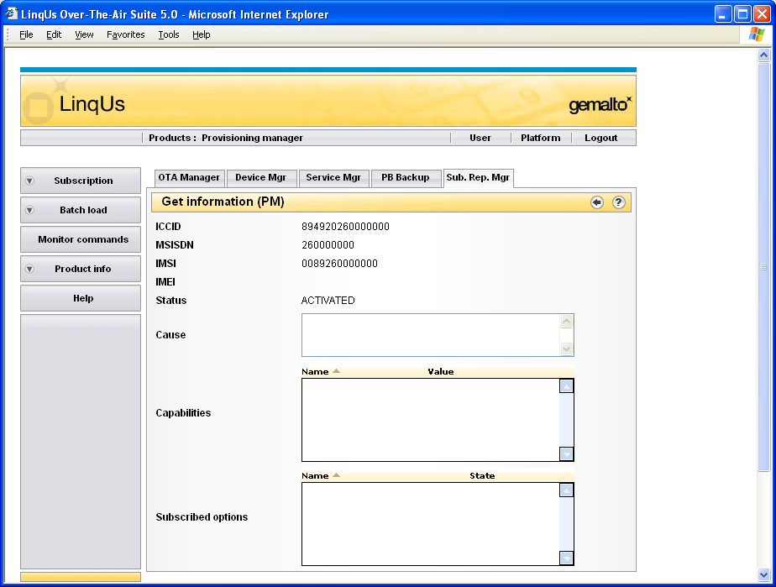
Interfase LPM / Obtener información de suscripción (5/5)
Obtener información > Administración de repositorio de suscriptores
Notes:
Get Information - Subscriber Repository Manager
The Get Information - Subscriber Repository window displays information for the selected subscription in the Subscriber Repository Manager product.
The following information about the selected subscription is displayed:
■ ICCID. The Integrated Circuit Card Identifier (ICCID) of the device associated with the subscription.
■ MSISDN. The Mobile Station International Subscriber Identifier Number (MSISDN) of the subscriber associated with the subscription.
■ IMSI. The International Mobile Subscriber Identifier (IMSI) of the card associated with the subscription.
■ IMEI. The International Mobile Equipment Identifier (IMEI) of the device associated with the subscription.
■ Status. The current state of the subscription (“ACTIVATED”, “CREATED”, “SUSPENDED”, “NOT IN USE”, or “CANCELED”).
■ Cause. Up to 50 characters describing the reason for changing the card’s state (Card state).
■ Capabilities. A list of all capabilities currently associated with the subscription.
Click the Sort icon to change the sort order of the properties displayed.
■ Subscribed options. A list of service options currently associated with the subscription. Click the Sort icon to change the sort order of the properties displayed.

Slide 17
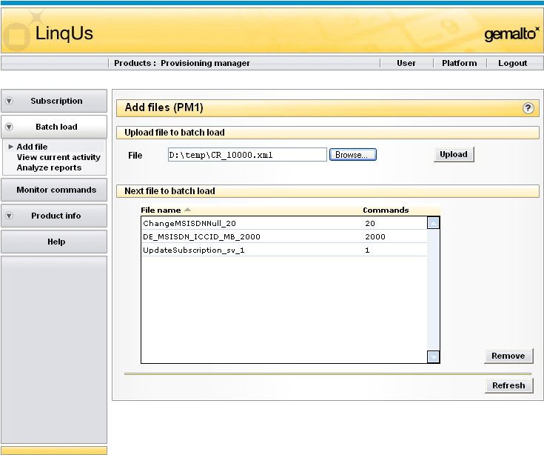
Interfase LPM / Batchload (1)
Notes:
Note 1: if the batchload file is a small one (few cards to batchload) it will be executed instantly and the file name will not appear in the « next file to batchload » list.
The file name appears if the batchload file is big and/or many bigs files to batchload one after the other.
Note 2: In case there is a structural xml pb in the file to batchload, no error will be displayed on this window, we have to go to Analyze report window and SAVE the report content and EDITH it with ULTRAEDITH. If you use the browser view you wont’ have the whole error message displayed.

Slide 18
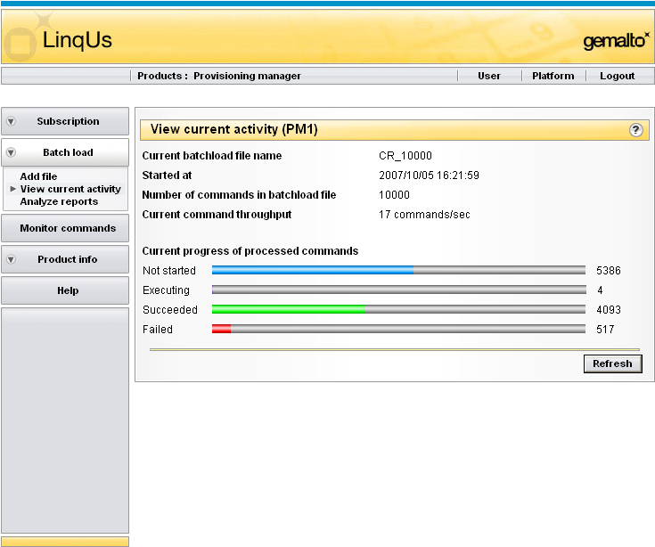
Interfase LPM / Batchload (2)
Ver actividad actual

Slide 19
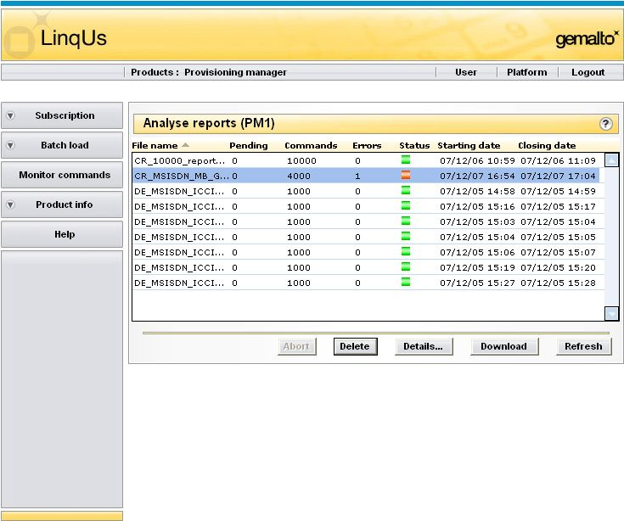
Interfase LPM / Batchload (3)
Para re ejecutar invocaciones con error
Para desargar archivo de reporte
Estatus. El estatus actual del archivo:
. El proceso del archivo se ha completado ( estatus “TERMINATED” OK).
. El archivo esta siendo procesado (estatus “IN PROCESS”).
. El proceso del archivo se ha completado , pero el archivo no pudo ser analizado
porque el formato de archivo no es válido (estatus “PARSING ERROR”).
. El proceso del archivo se ha completado , pero ocurrieron errores
(estatus “TERMINATED_ERROR”).

Slide 20
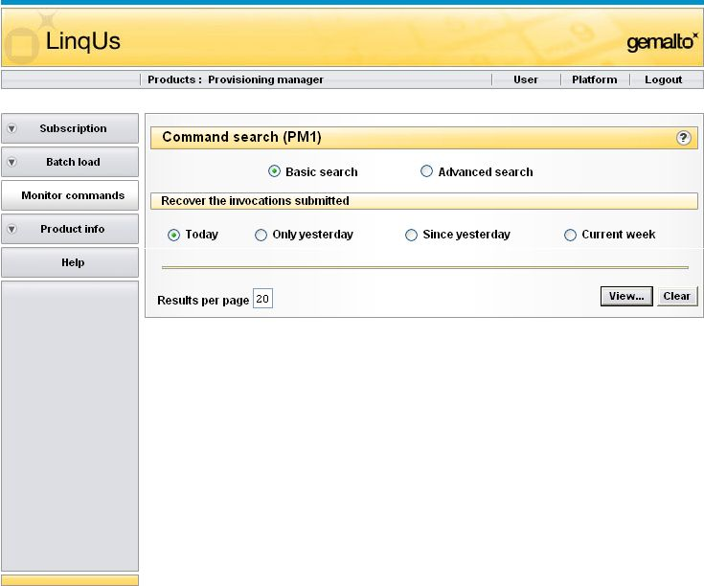
Interfase LPM / Monitoreo
Búsqueda básica

Slide 21
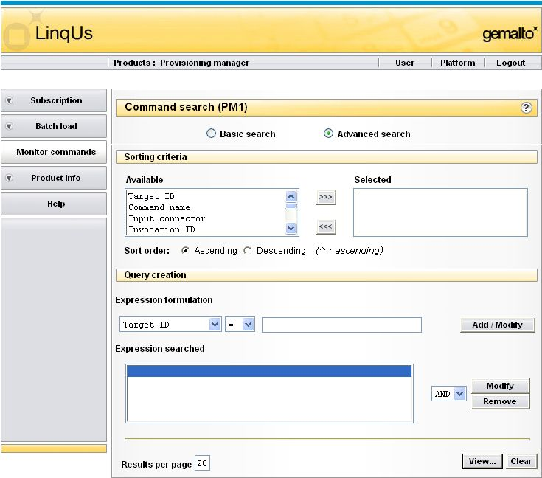
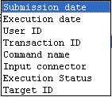

Interfase LPM / Monitoreo
Búsqueda avanzada

Slide 22
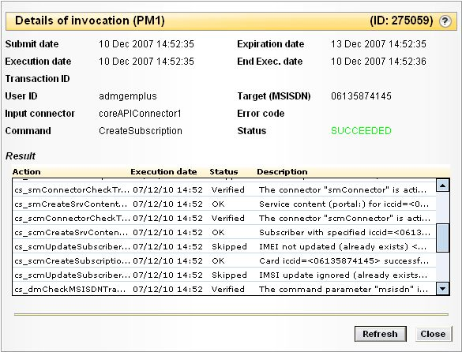
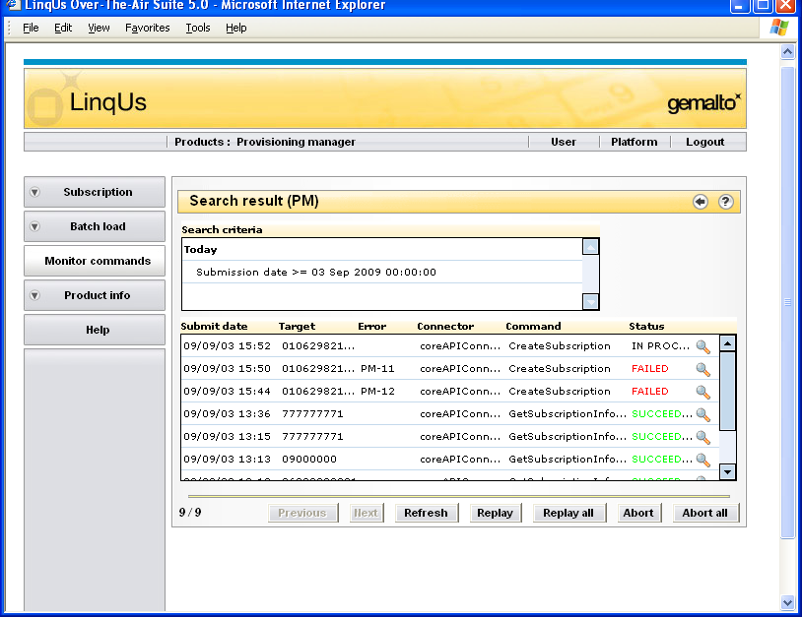
Interfase LPM / Monitoreo
Ver resultados
Operations enabled on already executed invocations

Slide 23
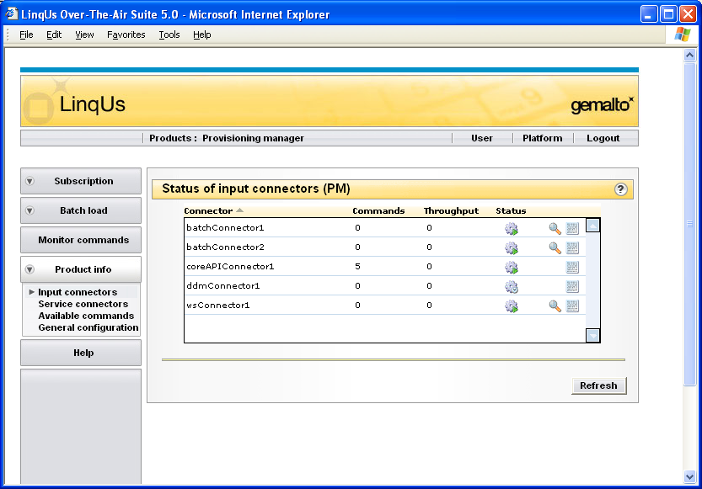
Interfase LPM / Conectores de entrada
Activar/Deactivar
Botón conector
Desplegar estado actual
Ver configuración de conector
Ver propiedades de conector

Slide 24

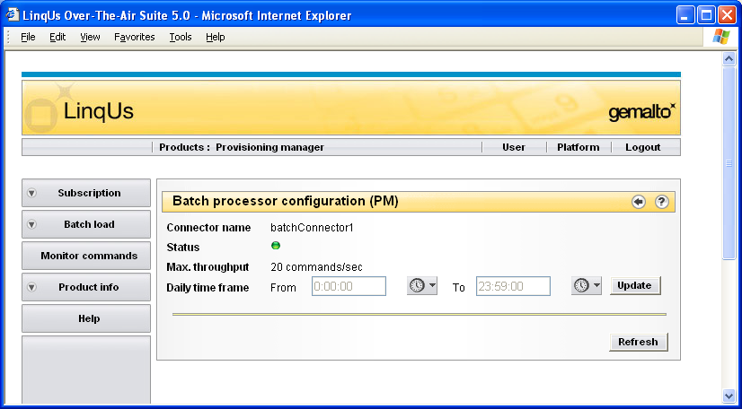
Interfase LPM / Conectores de entrada
Configuration de conector
Notes:
Note that the Max throughput value is set in LPM parameters.

Slide 25
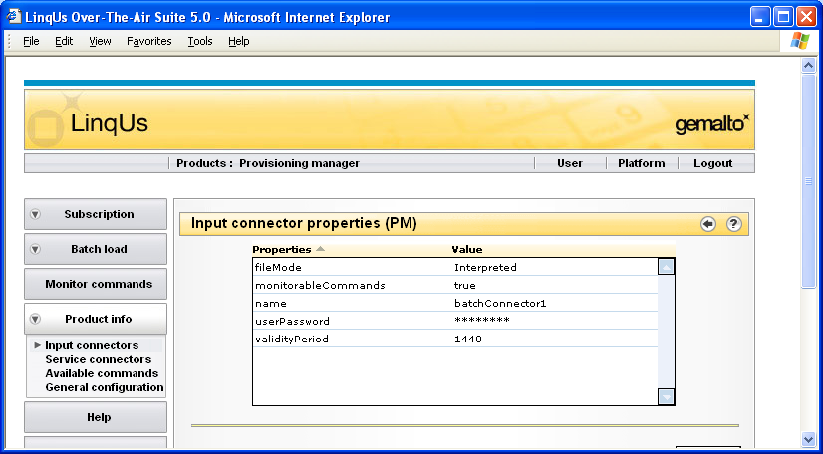
Interfase LPM / Conectores de entrada propiedades de conector

Slide 26
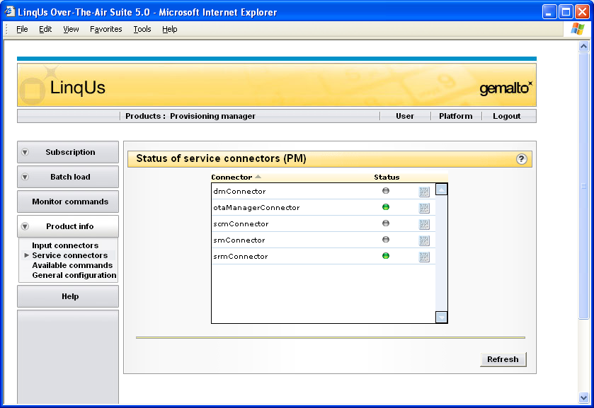
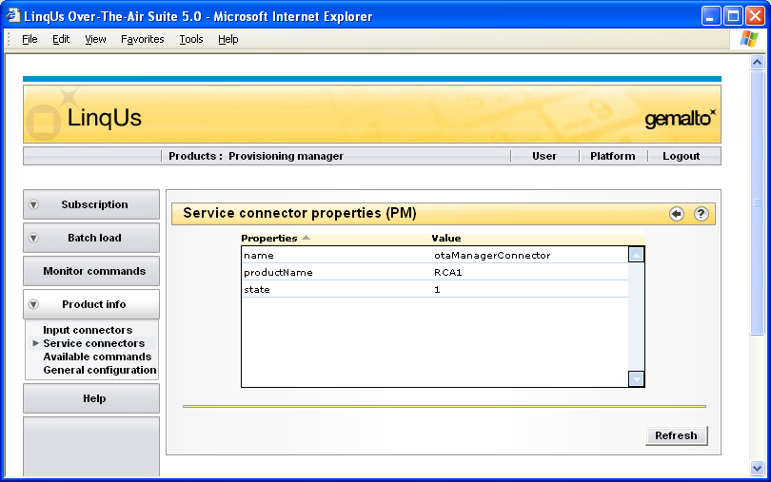
Interfase LPM / Conectores de servicio
Ver propiedades de conector
El estatus actual del conector de servicio:
El conector esta ACTIVO y DESCONECTADO.
El conector esta ACTIVO yCONECTADO
El conector esta DESACTIVADO.

Slide 27
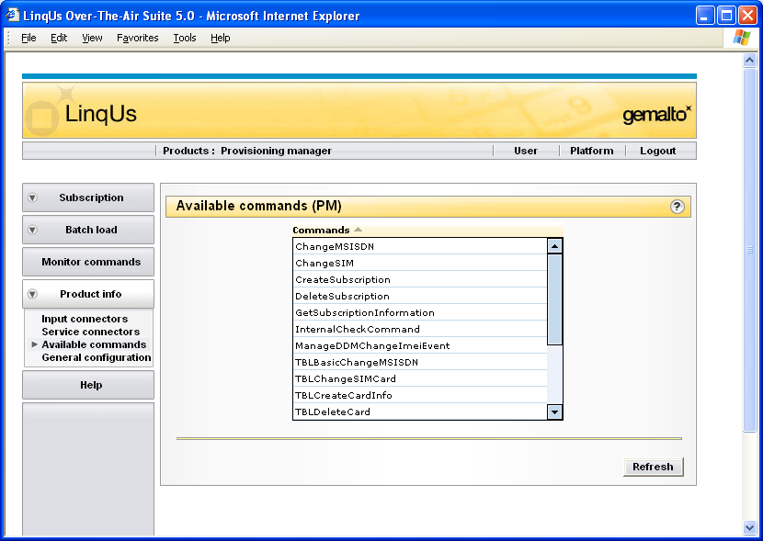
Interfase LPM / Lista de comandos disponibles

Slide 28
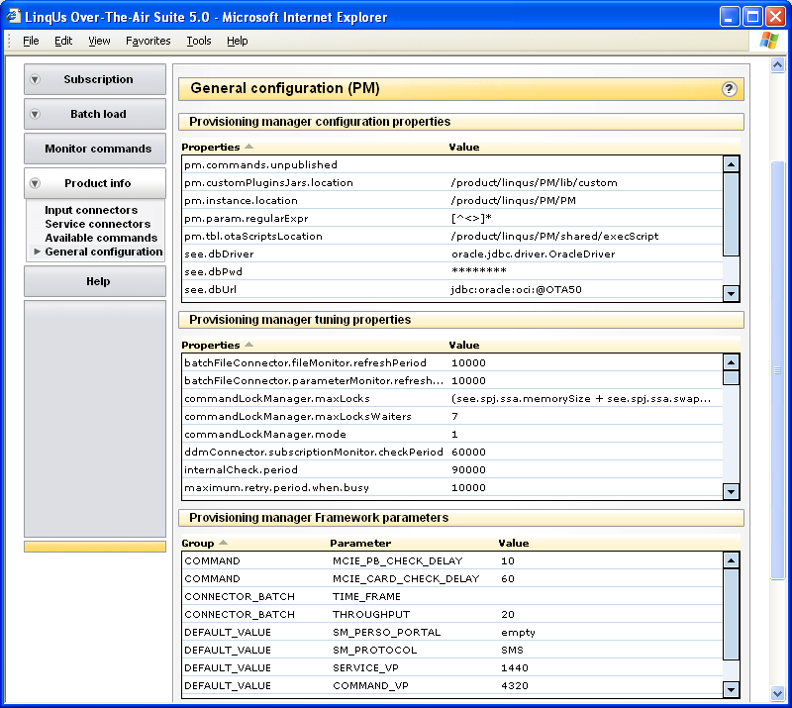
Interfase LPM / Configuración General

Slide 29
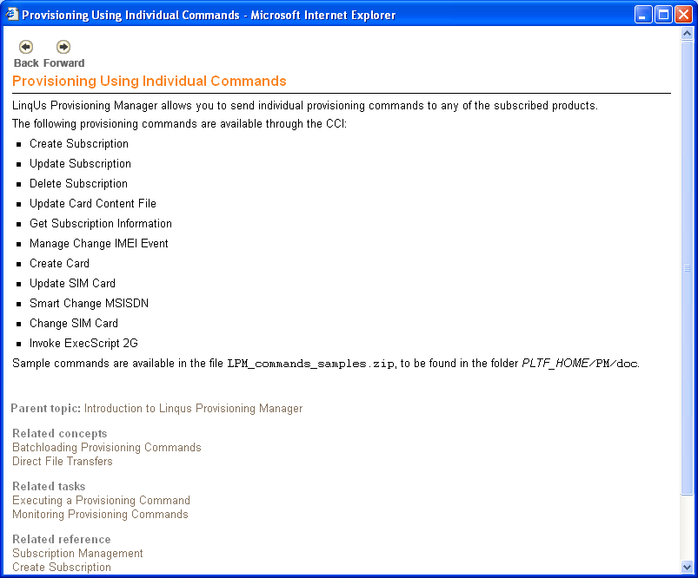
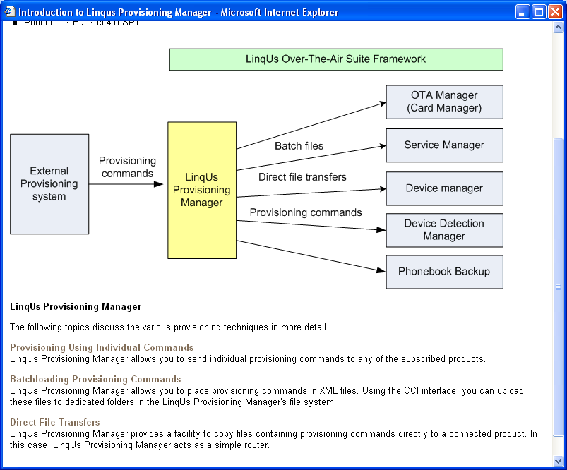
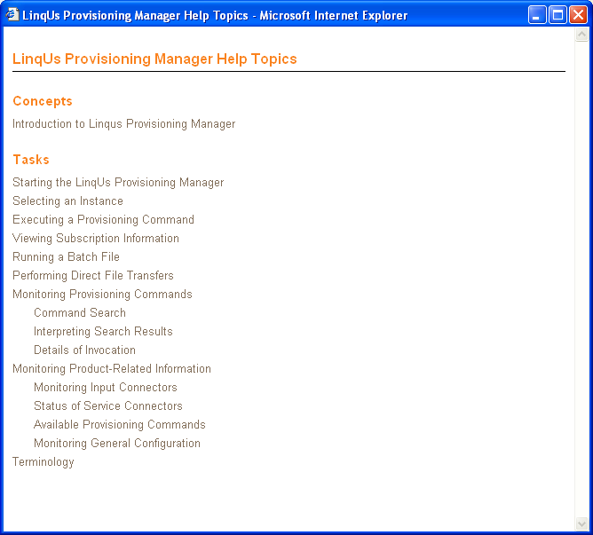
Interfase LPM / Menu Ayuda

